Slide 1
LECTURE 2 C# LANGUAGE Data types and Operators

Slide 2
Why C# ?
Native support for
Namespaces
Versioning
Attribute-driven development
Power of C with ease of Microsoft Visual Basic®
Minimal learning curve for everybody
Much cleaner than C++
More structured than Visual Basic
More powerful than Java

Slide 3
C# – The Big Ideas A component oriented language
The first “component oriented” language in the C/C++ family
In OOP a component is: A reusable program that can be combined with other components in the same system to form an application.
Example: a single button in a graphical user interface, a small interest calculator
They can be deployed on different servers and communicate with each other
Enables one-stop programming
No header files, IDL, etc.
Can be embedded in web pages

Slide 4
C# Overview
Object oriented
Everything belongs to a class
no global scope
Complete C# program:
using System;
namespace ConsoleTest
{
class Class1
{
static void Main(string[] args)
{
}
}
}

Slide 5
C# Program Structure
Namespaces
Contain types and other namespaces
Type declarations
Classes, structs, interfaces, enums, and delegates
Members
Constants, fields, methods, properties, events, operators, constructors, destructors
Organization
No header files, code written “in-line”
No declaration order dependence

Slide 6
COMMON TYPE SYSTEM OF CLR

Slide 7
Simple Types
Integer Types
byte, sbyte (8bit), short, ushort (16bit)
int, uint (32bit), long, ulong (64bit)
Floating Point Types
float (precision of 7 digits)
double (precision of 15–16 digits)
Exact Numeric Type
decimal (28 significant digits)
Character Types
char (single character)
string (rich functionality, by-reference type)
Boolean Type
bool (distinct type, not interchangeable with int)

Slide 8
Getting the exact size of datatype
using System;
namespace DataTypeApplication
{
class Program
{
static void Main(string[] args)
{
Console.WriteLine("Size of int: {0}", sizeof(int));
Console.ReadLine();
}
}
}

Slide 9
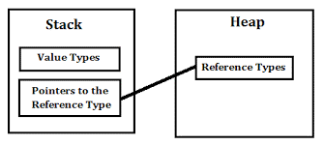
Value type vs. Reference type

Slide 10
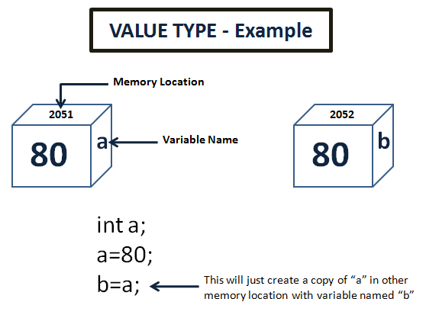

Slide 11
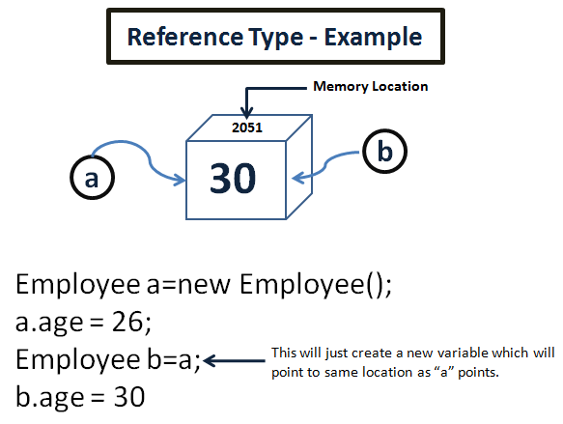

Slide 12
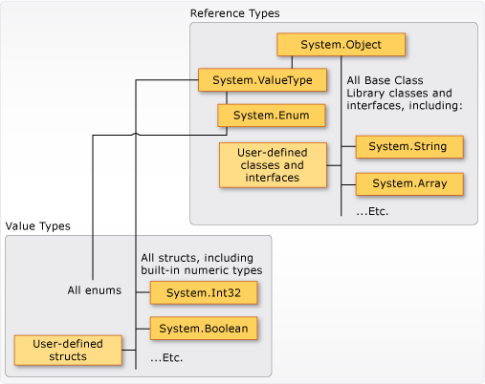

Slide 13
Ref and Out keywords
Ref keyword allow You to pass Value type by reference to the function
Should be initialized before passing to the function
Out keyword allow You to mark Value type as output Value by reference from the function
My be not itialized before passing to the function

Slide 14
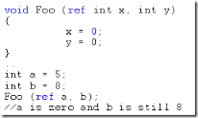

Slide 15
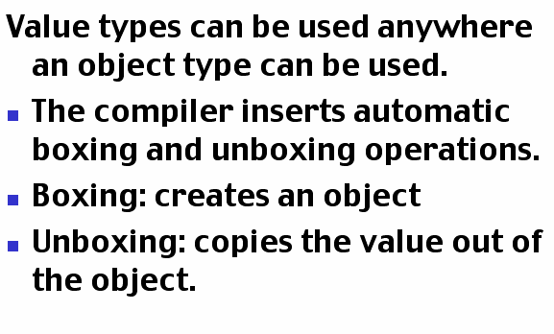
Boxing and Unboxing

Slide 16
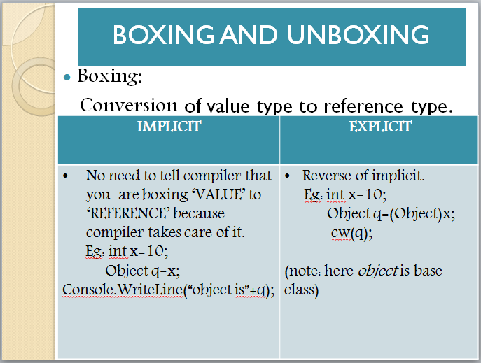

Slide 17
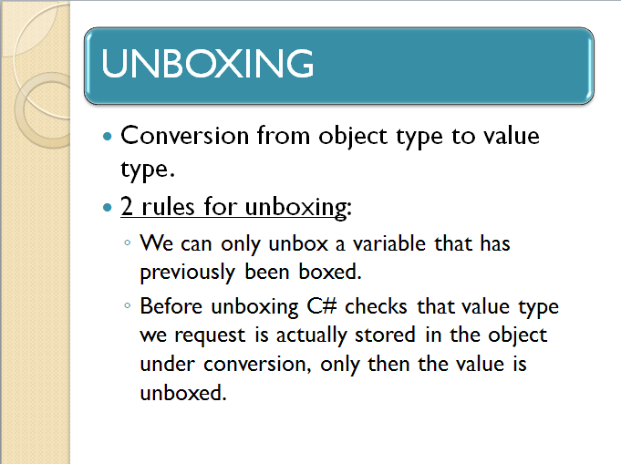

Slide 18
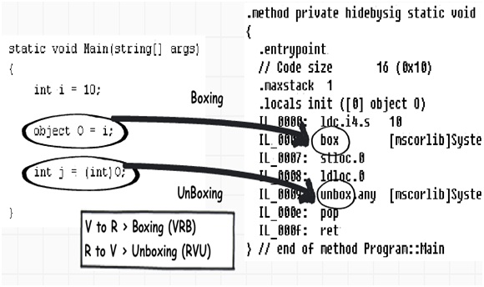

Slide 19
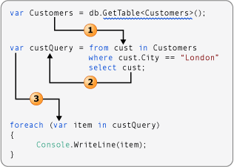
Var and Dynamic
Var – compile time data type deduction
Dynamic – runtime data type deduction (dangerous)
Used actively in reflection mechanism

Slide 20
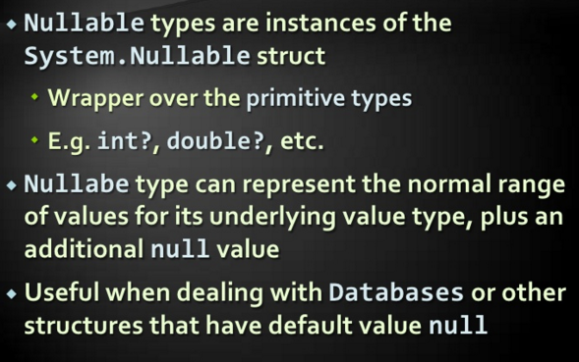
Nullable type

Slide 21
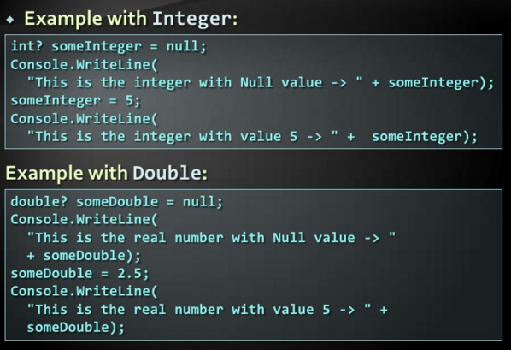
Nullable type example

Slide 22
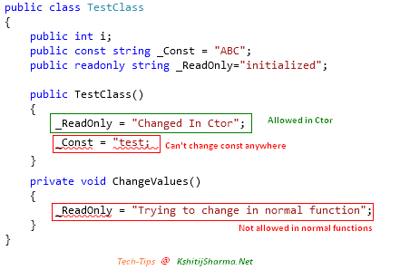
Constant and Readonly

Slide 23
Arrays
Zero based, type bound
Built on .NET System.Array class
Declared with type and shape, but no bounds
int [ ] SingleDim;
int [ , ] TwoDim;
int [ ][ ] Jagged;
Created using new with bounds or initializers
SingleDim = new int[20];
TwoDim = new int[,]{{1,2,3},{4,5,6}};
Jagged = new int[1][ ]; Jagged[0] = new int[ ]{1,2,3};

Slide 24
Statements and Comments
Case sensitive (myVar != MyVar)
Statement delimiter is semicolon ;
Block delimiter is curly brackets { }
Single line comment is //
Block comment is /* */
Save block comments for debugging!

Slide 25
Data
All data types derived from System.Object
Declarations:
datatype varname;
datatype varname = initvalue;
C# does not automatically initialize local variables (but will warn you)!

Slide 26
Value Data Types
Directly contain their data:
int (numbers)
long (really big numbers)
bool (true or false)
char (unicode characters)
float (7-digit floating point numbers)
string (multiple characters together)

Slide 27
Data Manipulation
= assignment
+ addition
- subtraction
* multiplication
/ division
% modulus
++ increment by one
-- decrement by one

Slide 28
strings
Immutable sequence of Unicode characters (char)
Creation:
string s = “Bob”;
string s = new String(“Bob”);
Backslash is an escape:
Newline: “\n”
Tab: “\t”

Slide 29
string/int conversions
string to numbers:
int i = int.Parse(“12345”);
float f = float.Parse(“123.45”);
Numbers to strings:
string msg = “Your number is ” + 123;
string msg = “It costs ” +
string.Format(“{0:C}”, 1.23);

Slide 30
String Example
using System;
namespace ConsoleTest
{
class Class1
{
static void Main(string[ ] args)
{
int myInt;
string myStr = "2";
bool myCondition = true;
Console.WriteLine("Before: myStr = " + myStr);
myInt = int.Parse(myStr);
myInt++;
myStr = String.Format("{0}", myInt);
Console.WriteLine("After: myStr = " + myStr);
while(myCondition) ;
}
}
}

Slide 31
Arrays
(page 21 of quickstart handout)
Derived from System.Array
Use square brackets [ ]
Zero-based
Static size
Initialization:
int [ ] nums;
int [ ] nums = new int[3]; // 3 items
int [ ] nums = new int[ ] {10, 20, 30};

Slide 32
Arrays Continued
Use Length for # of items in array:
nums.Length
Static Array methods:
Sort System.Array.Sort(myArray);
Reverse System.Array.Reverse(myArray);
IndexOf
LastIndexOf
Int myLength = myArray.Length;
System.Array.IndexOf(myArray, “K”, 0, myLength)

Slide 33
Arrays Final
Multidimensional
// 3 rows, 2 columns
int [ , ] myMultiIntArray = new int[3,2]
for(int r=0; r<3; r++)
{
myMultiIntArray[r][0] = 0;
myMultiIntArray[r][1] = 0;
}

Slide 34
Pointers
The pointers have the same syntax as in c++ (using ASTERIX - *)
Int *p;

Slide 35
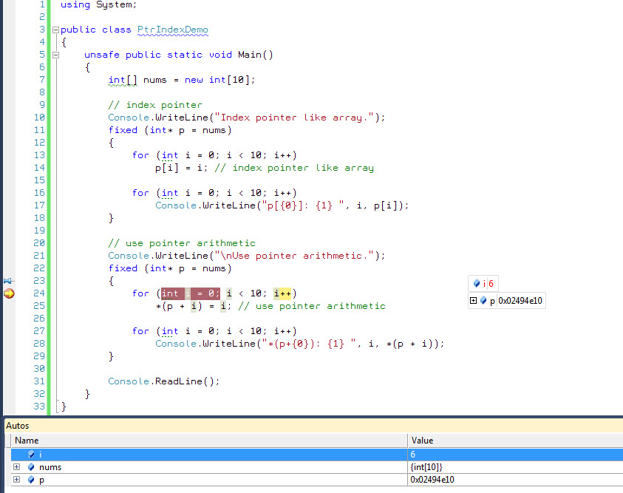

Slide 36
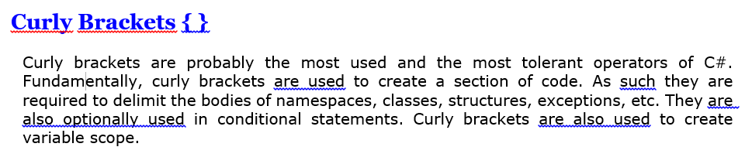
OPERATORS AND OPERANDS

Slide 37
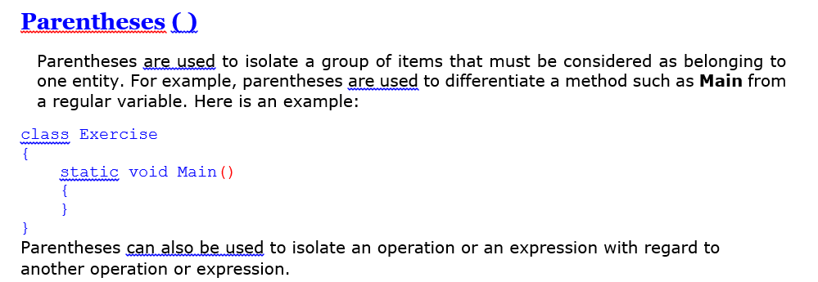

Slide 38
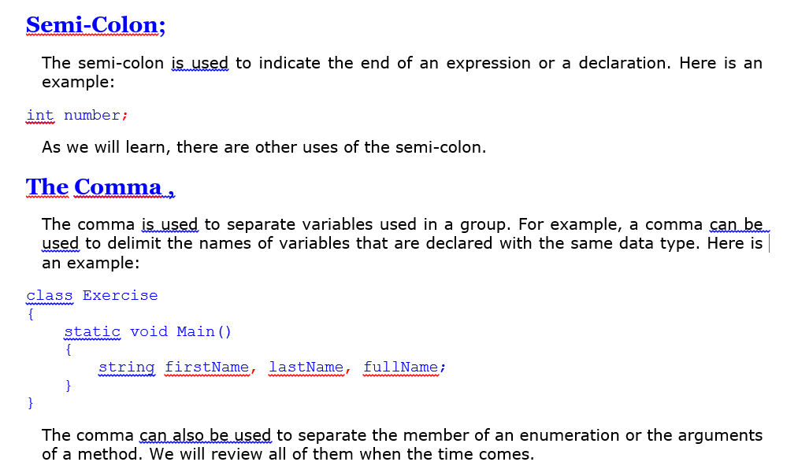

Slide 39
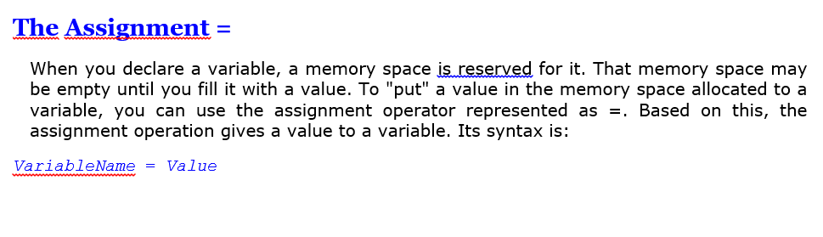
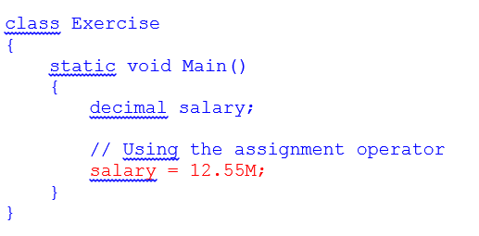

Slide 40
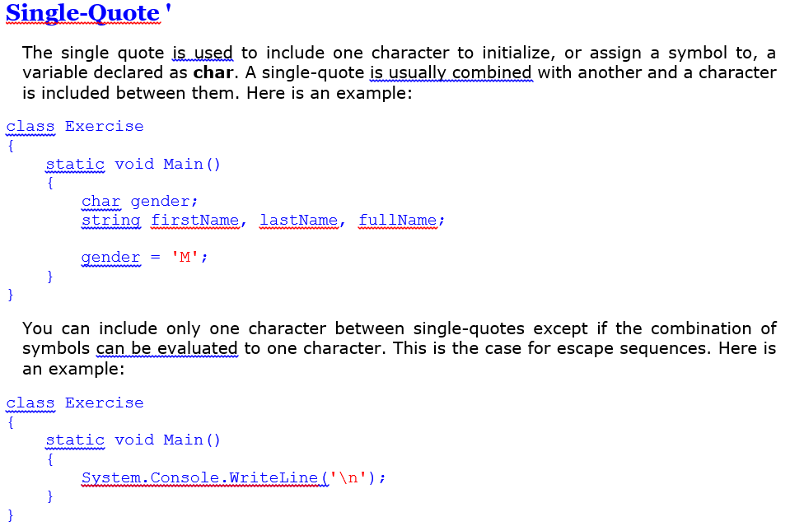

Slide 41
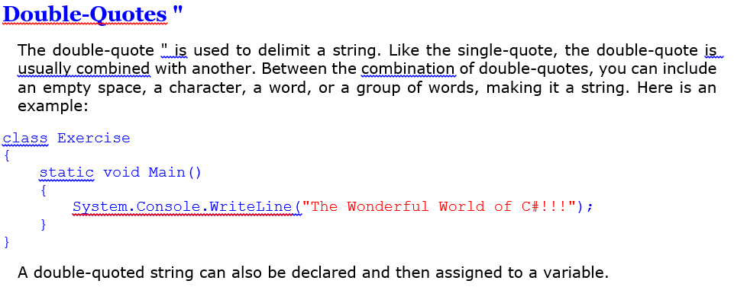

Slide 42
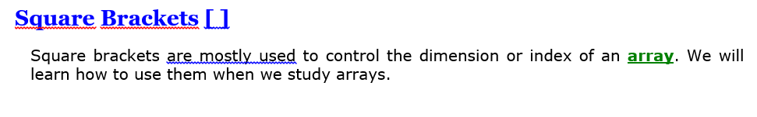

Slide 43
Operations
Arithmetic
+
-
/
*
++
--
Bitwise
~ - reverse
& - conjunction
| - disjunction
^ - exclusion
<< - shift left
>> - shift right
Conditional Logic
&& - and
|| - or

